Slide 1
Use of Digital Technology to calculate water footprints for different daily use items.
CSE7101- Capstone Project
Review-1
Batch Number: CIT_26
Under the Supervision of,
Ms. Chandana C
Assistant Professor
School of Information Science
Presidency University
Roll Number | Student Name
20221CIT0049 | C M SHALINI
20221CIT0043 | AMRUTHA M
20221CIT0151 | VASHINI R
Name of the Program: B. Tech(Computer Science & Engineering (Internet of Things) )
Name of the HoD: Dr. Anandaraj S.P
Name of the Program Project Coordinator: Dr . Sharmasth Vali
Name of the School Project Coordinators: Dr . Sampath A K , Dr . Geetha A

Slide 2
Problem Statement Number: PSCS_4
Organization: Ministry of Jal Shakti
Category (Hardware / Software / Both) : Software
Problem Description:
Freshwater scarcity is a major global challenge.
Most people are unaware of daily water consumption in products and activities.
Existing studies on water usage are not user-friendly for individuals.
The project will create a digital platform to calculate and visualize water footprints.
Goal: Help users adopt sustainable practices and reduce unnecessary water consumption.

Slide 3
Content
Problem Statement
Objectives
Background and Related work for title Selection
Analysis of Problem Statement
Innovation or Novel Contributions
Git-hub Link
Timeline of the Project
References

Slide 4
Problem Statement and Objectives
Problem Statement :
Use of Digital Technology to calculate water footprints for different daily use items.
Objectives :
Awareness Creation
User-Friendly Digital Solution
Data Accessibility
Behavioral Change & Action
Policy & Research Support
Preventive Impact

Slide 5
Background and Related work for title Selection
Background:
Water scarcity is rising due to climate change, urbanization, and population growth.
By 2050, 52% of people may live in water-stressed regions (UNESCO).
Water Footprint (2002): Tracks direct + indirect freshwater use in goods and services.
India: Faces groundwater depletion, pollution, and inefficient water use.
Need: Public awareness of daily water use for sustainable management.
Related work for title Selection :
Related Work
WFN
WFN Online Tool
WWF Risk Filter
Eco Apps (Oroeco, JouleBug)
Indian Studies – Highlight water use in agriculture/industry but lack citizen-friendly tools.

Slide 6
Analysis of Problem Statement
Technology Stack Components : The project uses a modern, lightweight, and scalable stack for efficient water footprint calculation and visualization.
Frontend: HTML, CSS and JS, Streamlit
Backend: Fast API micro-service
Database: PostgreSQL for items/logs, Redis cache for fast lookups.
AI/ML: Linear Regression, Decision tree regressor, Gradient Boosting regressor, Random forest regressor and XG Boost

Slide 7
Analysis of Problem Statement (contd...)
Software Requirements:
Frontend:
HTML, CSS, JavaScript – for structure, styling, and interactivity
Streamlit – framework for creating interactive dashboards and visualizations
Backend:
FastAPI (Python) – microservice framework for building high-performance REST APIs and handling water footprint calculation logic
Database:
PostgreSQL – relational database for storing items, user accounts, and consumption logs
Redis – in-memory caching layer to improve query performance and speed up repeated lookups

Slide 8
Analysis of Problem Statement (contd...)
AI/ML Layer: Used for prediction, trend analysis, and providing personalized recommendations:
Linear Regression – baseline model for interpretability
Decision Tree Regressor – handles non-linear usage patterns
Random Forest Regressor – ensemble method to improve robustness
Gradient Boosting Regressor – strong predictive performance on structured data
XGBoost – optimized boosting algorithm with high accuracy and efficiency
Development & Deployment Tools:
Git & GitHub Actions – version control and CI/CD automation

Slide 9
Github Link
GitHub Link :
https://github.com/vASHINI2003/Water-Footprints
The GitHub link provided should have public access permission.
GitHub Link: A URL that provides access to your project’s code repository hosted on GitHub.
It allows others to view, download, collaborate, and contribute to your project’s development.

Slide 10
Analysis of Problem Statement (contd...)
Hardware Requirements:
Minimum (Development Environment)
Processor: Intel i3 (or equivalent)
RAM: 4 GB
Storage: 100 GB HDD
Recommended (Development + Deployment)
Processor: Intel i5
RAM: 8 GB or above
Storage: 250 GB SSD
Internet: Stable connection for cloud deployment
Optional (Cloud/Server Deployment)
2–4 vCPUs

Slide 11
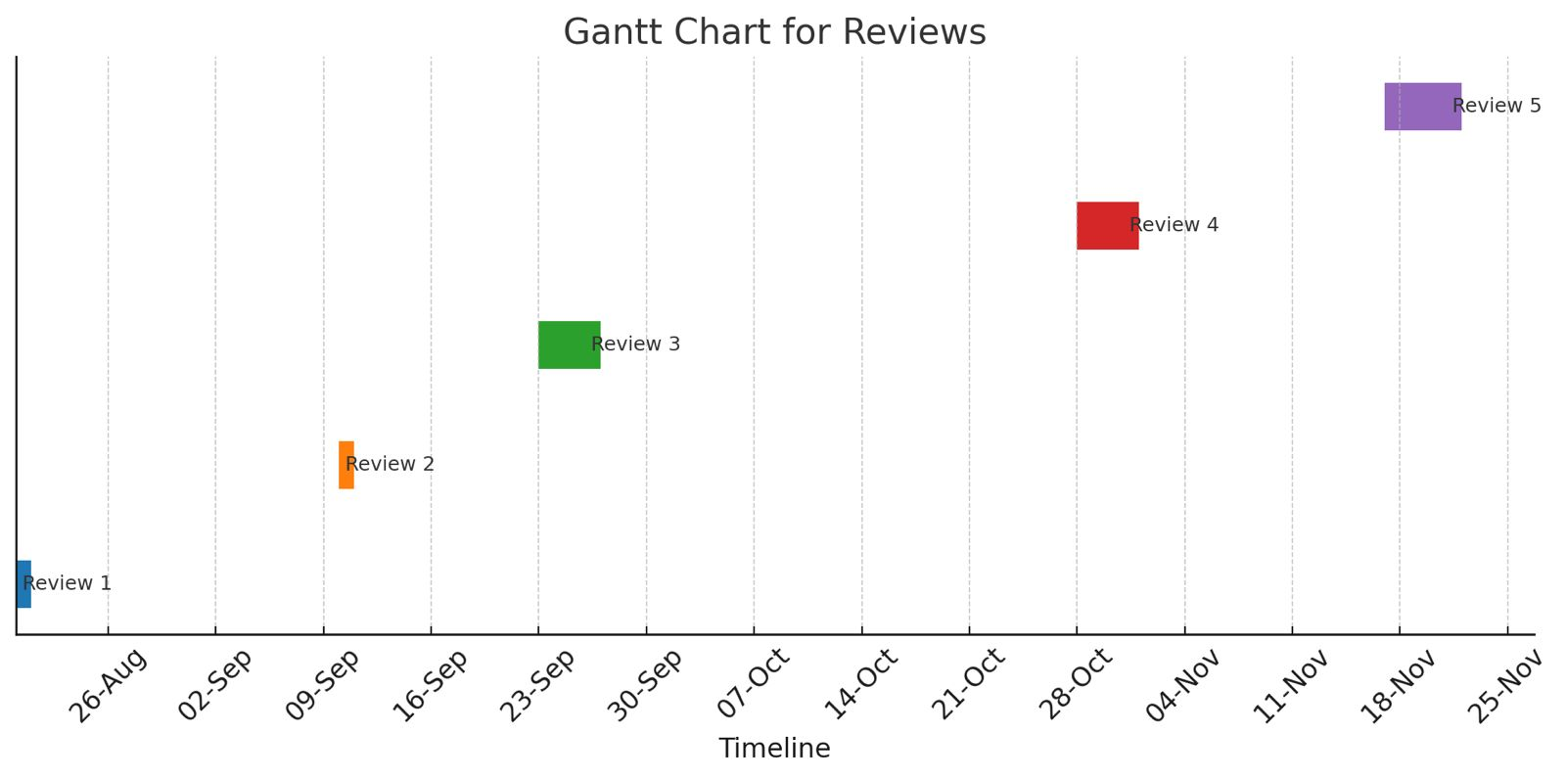
Timeline of the Project (Gantt Chart)
Gantt Chart for Reviews :

Slide 12
References (IEEE Paper format)
[1] Meghnadh Bijnapally , Shubranshu ranjan dash , Vikyath reddy Sama “Water Footprint Calculator: Tracking Daily Water Usage with Digital Tech ", JNRID - JOURNAL OF NOVEL RESEARCH AND INNOVATIVE DEVELOPMENT (www.JNRID.org), ISSN:2984-8687, Vol.2, Issue 11, page no.a109-a121, November-2024,
[2] Hoekstra, A.Y., et al. "The Water Footprint of Humanity." PNAS, 2012. [2] Mekonnen, M.M.,Hoekstra, A.Y. "A Global Assessment of the Water Footprint of Farm Animal Products."Ecosystems, 2012. [3] FAO, UNESCO reports on water use and sustainability. [4] Recent work on AI in sustainability (Nature Sustainability, IEEE Access)

Slide 13


